Slide 1
Differentiated Instruction
Cindy Carro and Karen Ditthardt

Slide 2
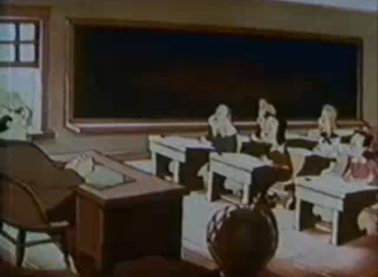
What it’s not…

Slide 3
What is it???
Differentiation means tailoring instruction to meet individual needs. Or in other words, a teacher differentiates instruction by responding to variance among learners in order to create the best learning experience possible.
Whether teachers differentiate content, process, products, or the learning environment, the use of ongoing assessments and flexible grouping makes this a successful approach to instruction.
Tomlinson, C.A. (August 2000). Differentiation of Instruction

Slide 5
Why differentiate?
Intelligence is variable!
The brain hungers for meaning.
Humans learn best with moderate challenge.
Tomlinson, C.A. (1999). The Differentiated Classroom.

Slide 6
Keeping in mind student interest, readiness, and learning profiles…..
….what can we differentiate?

Slide 7
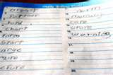
Content
What the student needs to learn or how the student will get access to the information
Tomlinson, C.A. (August 2000). Differentiation of Instruction

Slide 8
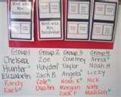
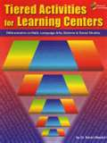
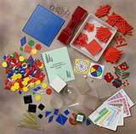
Process
Activities in which the student engages in order to make sense of or master the content
Tomlinson, C.A. (August 2000). Differentiation of Instruction

Slide 9
Products
Culminating projects that ask the student to rehearse, apply, and extend what he or she has learned in a unit
Tomlinson, C.A. (August 2000). Differentiation of Instruction

Slide 10
Learning Environment
The way the classroom works and feels
Tomlinson, C.A. (August 2000). Differentiation of Instruction

Slide 11
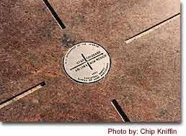
FOUR CORNERS

Slide 12
Where Do We Go Next?
Let’s Debrief!
Thank You!

